Slide 1
Django

Slide 2
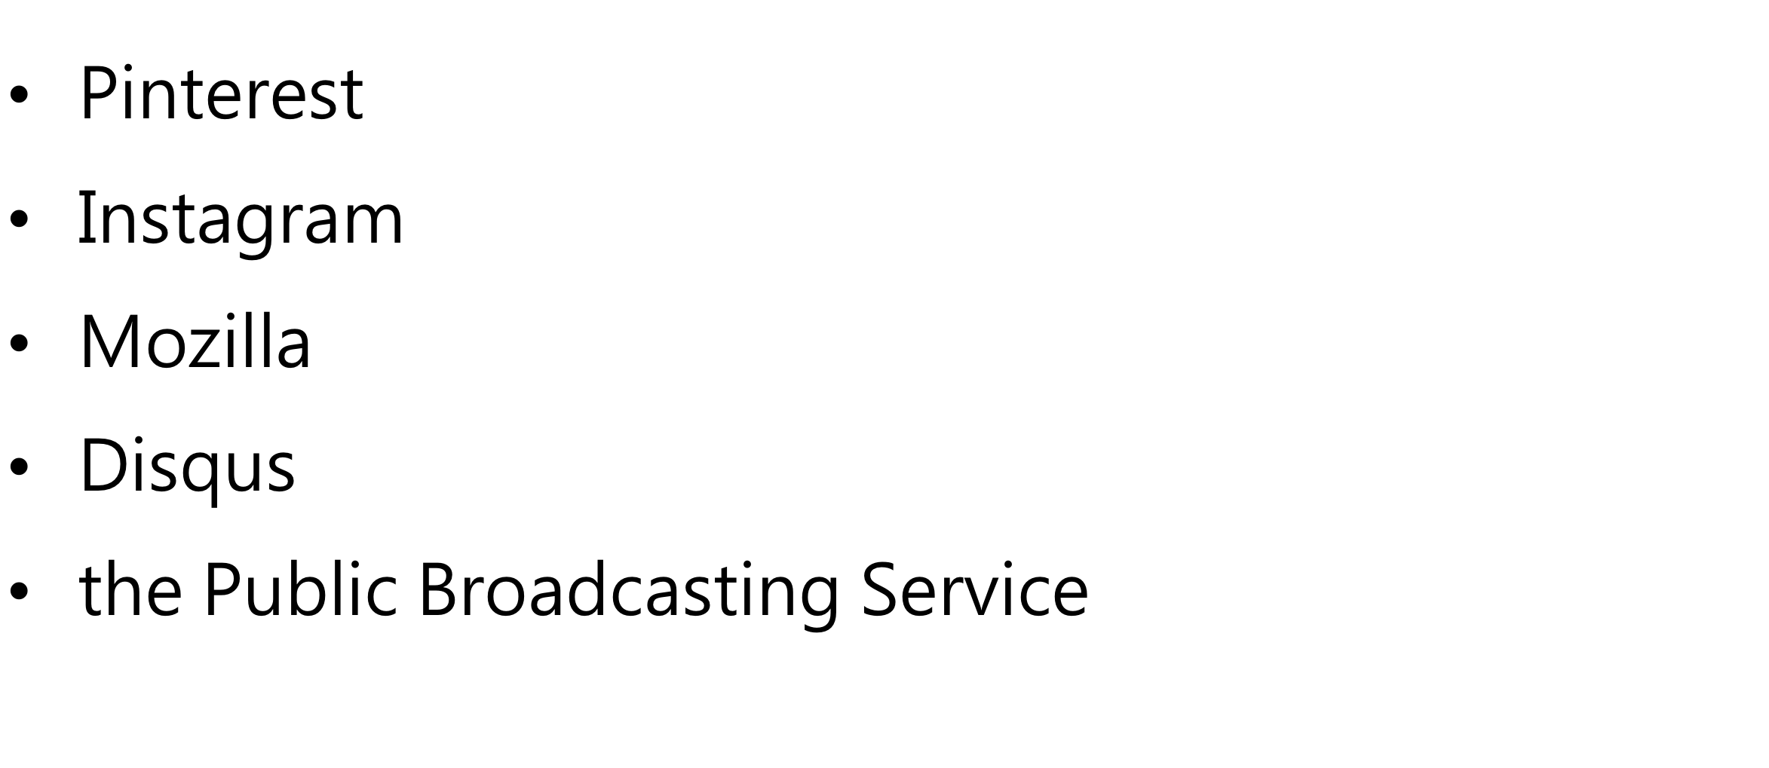
有誰在使用Django

Slide 3
Why Django
歷史悠久：今年(2018)邁入第11年，經得起考驗。
市場佔有率最高
最完善的技術文件
豐富的套件
強大的社群
提供total solution，初學者可以透過Django內建的
模塊了解網站運作。

Slide 4
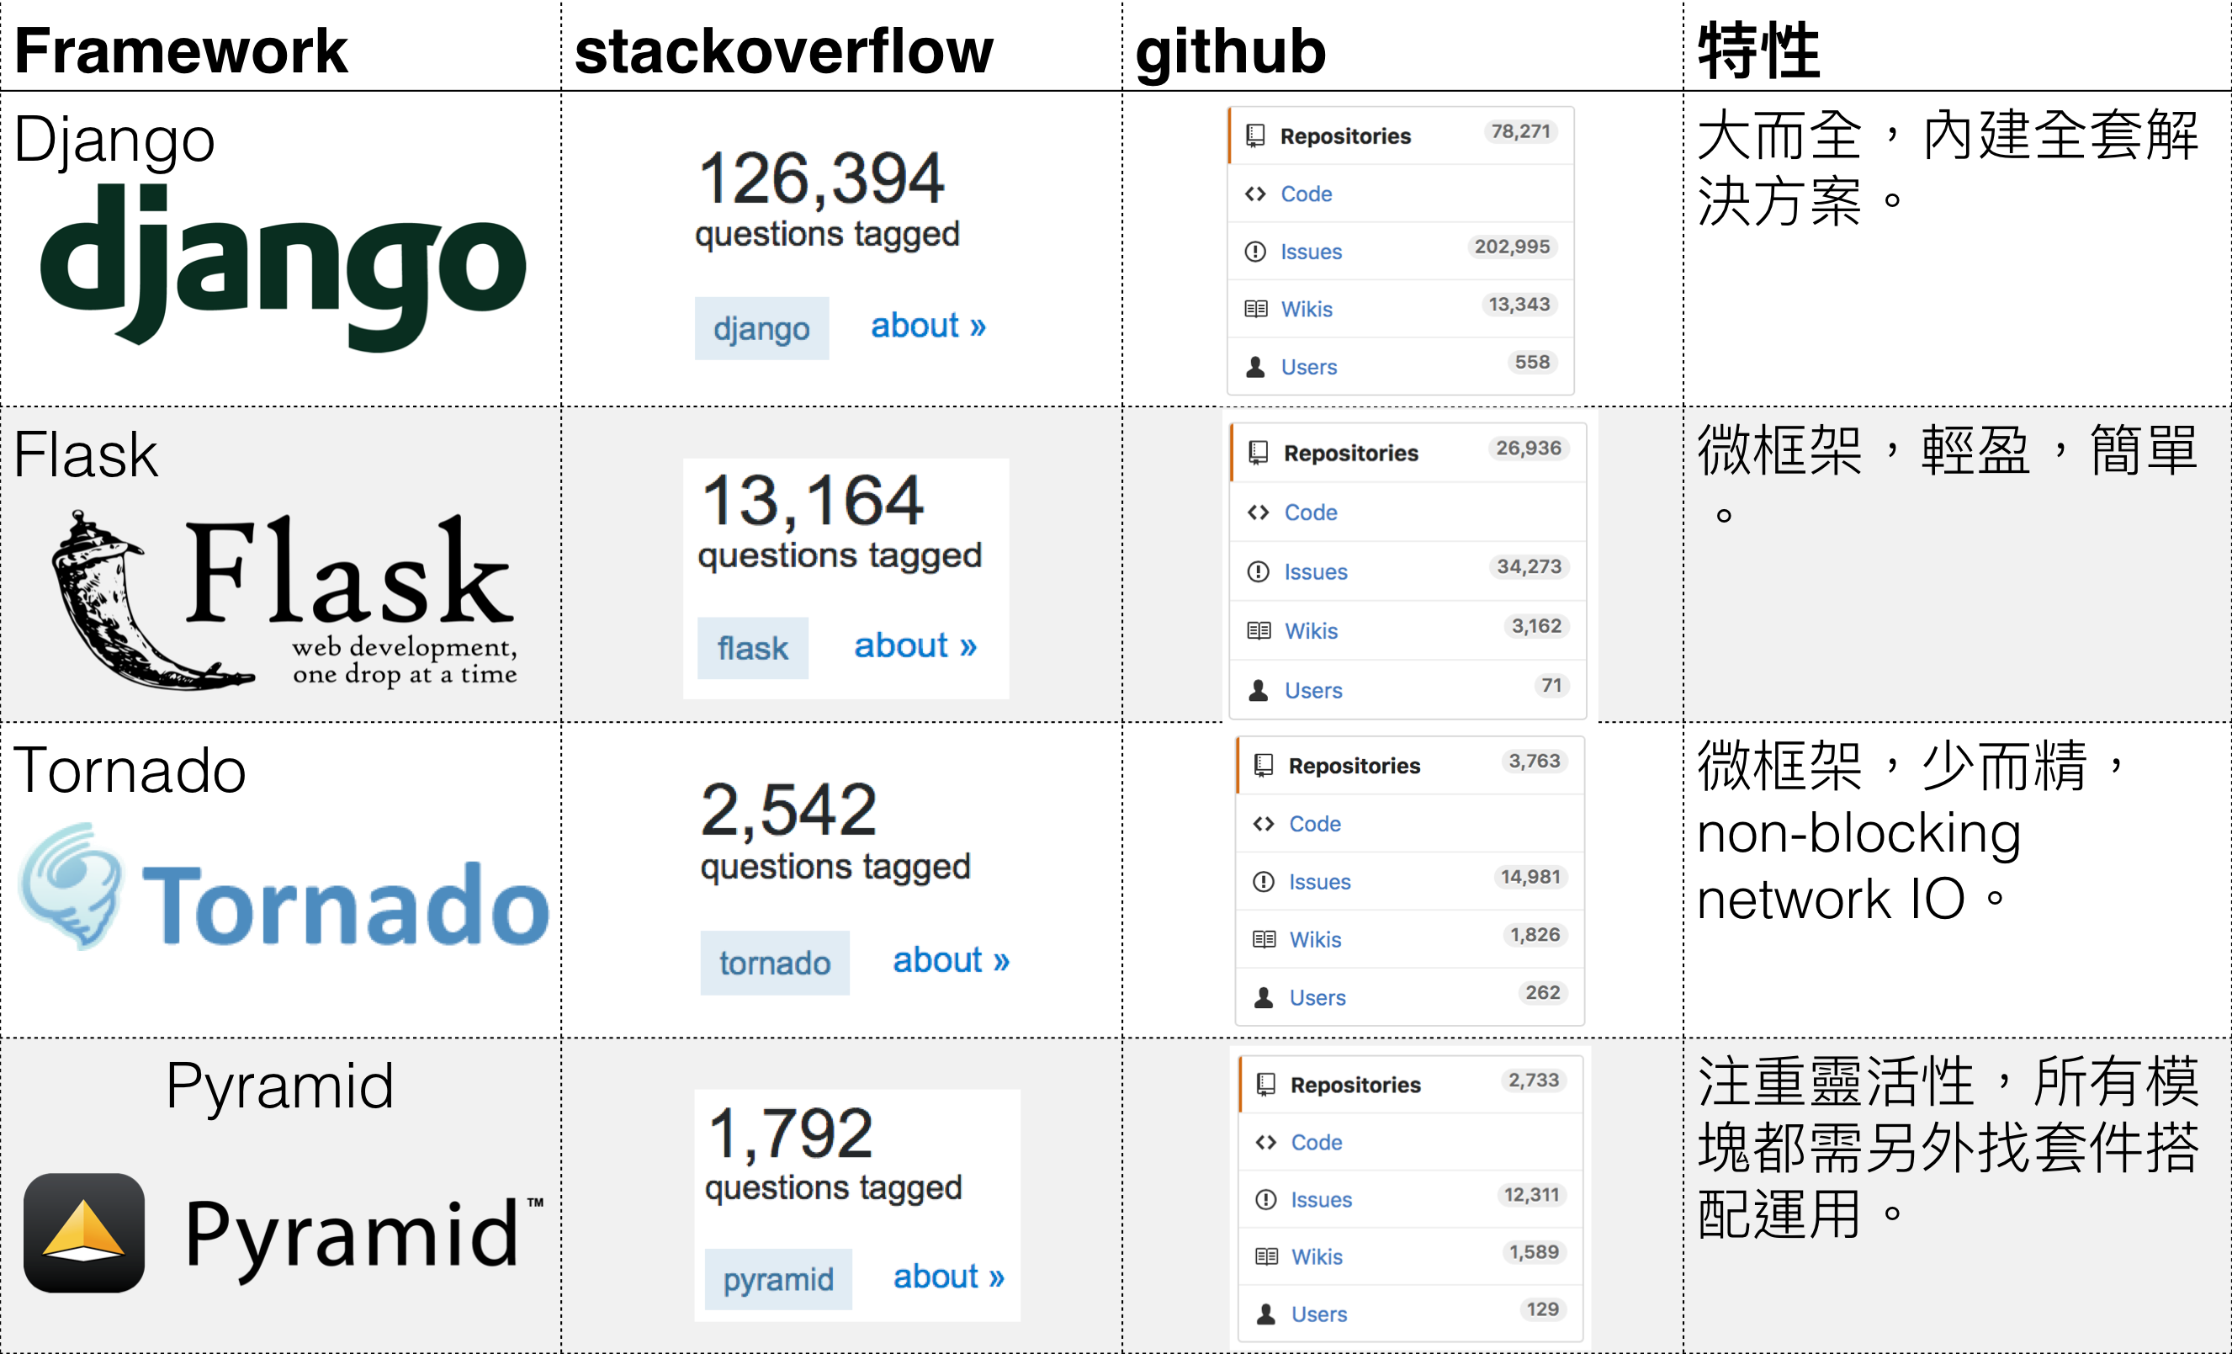

Slide 5


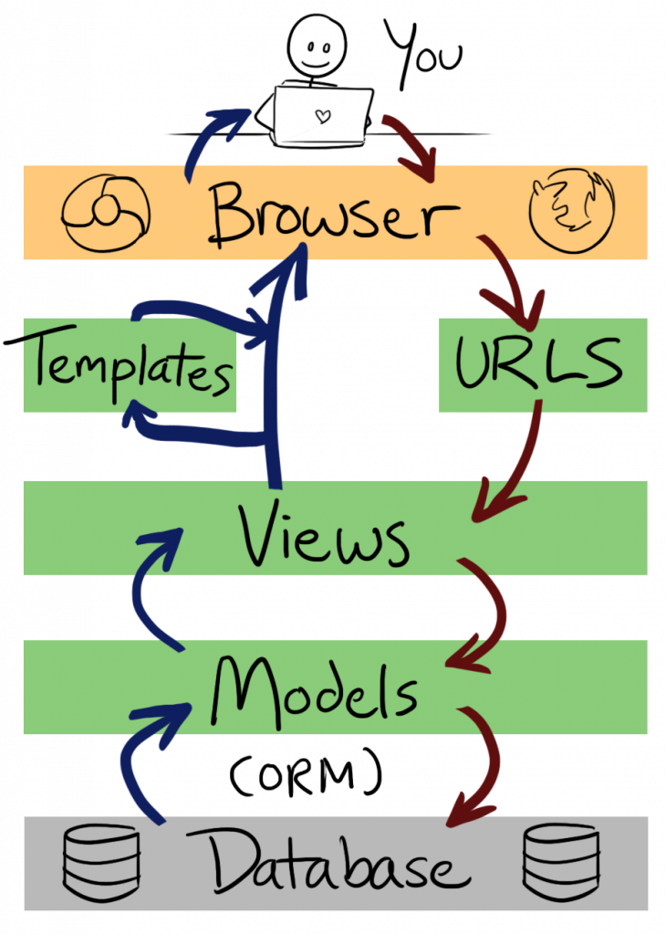
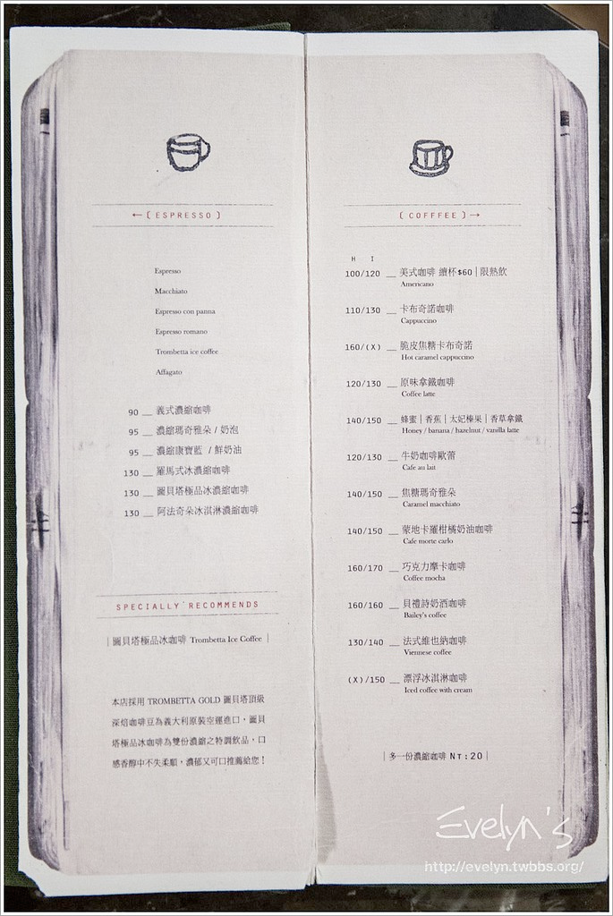

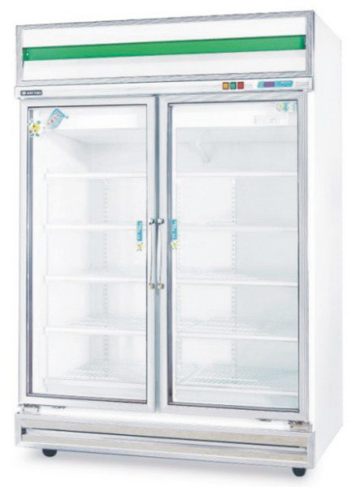
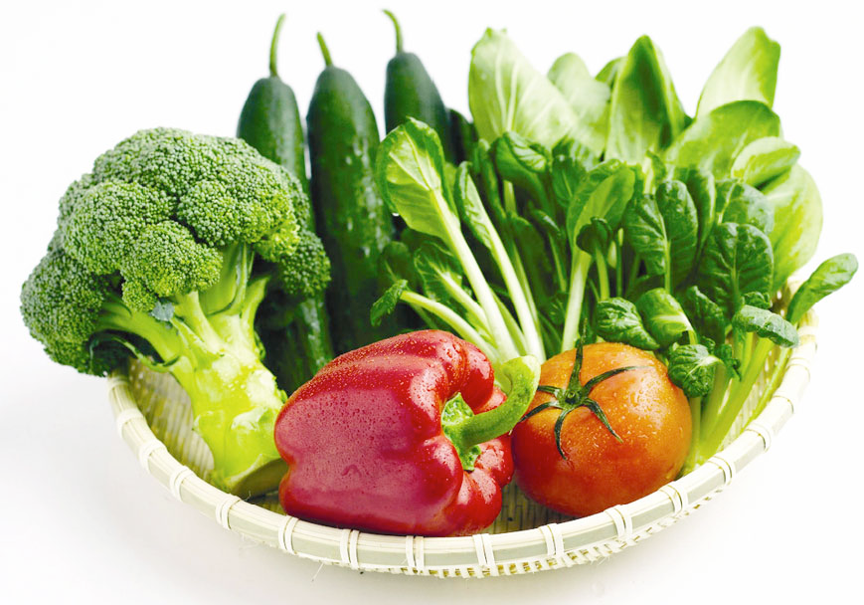
MTV(MVC)

Slide 6
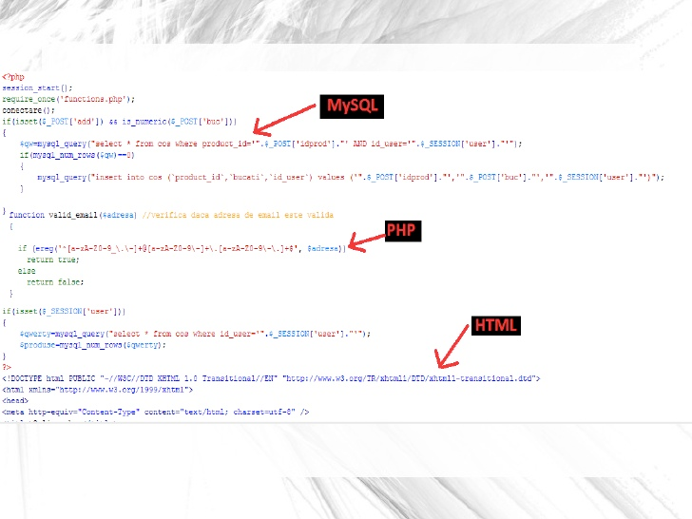
Why MVC?
圖片轉載自：http://www.slideshare.net/AndreiAvadanei/spaghetti-code-vs-mvc

Slide 7


Spaghetti Code

Slide 8
Why MVC?
分離商業邏輯與UI
前後端可獨立作業
擁有更多彈性
較容易維護
降低複雜度

Slide 9

models.py
views.py
templates

Slide 10
MTV(MVC)

Slide 11
常見的類MVC架構
PHP: Zend Framework
Python: Django
Ruby: Ruby on Rails
.NET: ASP.NET MVC
…

Slide 12
安裝
pip install django
pip freeze | grep Django

Slide 13
暖個身，
先來做個簡單的Blog吧

Slide 14
建置project
mkdir myproject
cd myproject
django-admin startproject project .
myproject
├─ manage.py
└─ project
settings.py
urls.py
wsgi.py
__init__.py

Slide 15

設定資料庫
myproject/project
vi settings.py
settings.py
DATABASES = {
'default': {
'ENGINE': 'django.db.backends.sqlite3',
'NAME': os.path.join(BASE_DIR, 'db.sqlite3'),
}
}
myproject/
python manage.py migrate

Slide 16
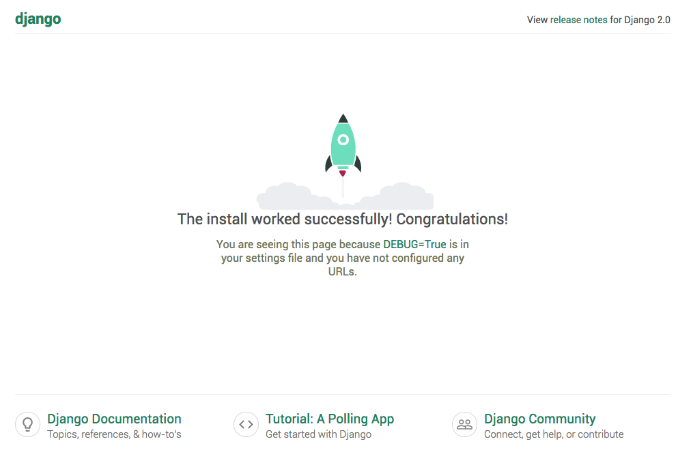
測試server
myproject/
python manage.py runserver 8000
輸入網址：127.0.0.1:8000

Slide 17
建置app
myproject/
python manage.py startapp blog
myproject
├── db.sqlite3
├── project
| __init__.py
| settings.py
| urls.py
| wsgi.py
├── manage.py
└── blog
├── migrations
| __init__.py
├── __init__.py
├── admin.py
├── models.py
├── tests.py
└── views.py

Slide 18
建置app
myproject/project
vi settings.py
settings.py
INSTALLED_APPS = (
'django.contrib.admin',
'django.contrib.auth',
'django.contrib.contenttypes',
'django.contrib.sessions',
'django.contrib.messages',
'django.contrib.staticfiles',
'blog',
)

Slide 19

建置app
兩層架構：
- project (project)
- app (blog)
可只用project層就做完網站。
app層可以多個。
app層讓架構分明以外，可作為可拔插的元件，
供任何project使用。

Slide 20
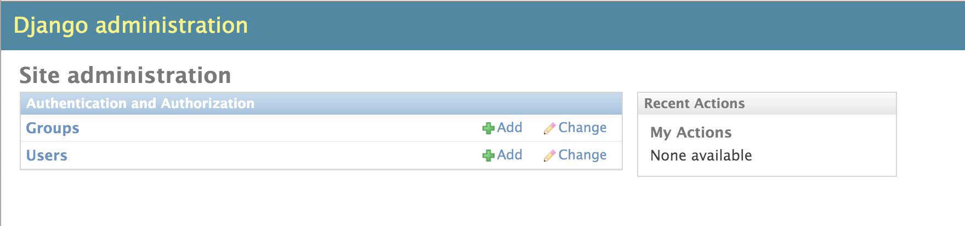
後台管理介面
myproject/
python manage.py createsuperuser
設定user, password,e-mail
輸入網址：127.0.0.1:8000/admin/

Slide 21
ADDING MODEL
myproject/blog/models.py
models.py
from django.db import models
from django.utils import timezone
class Post(models.Model):
author = models.ForeignKey(‘auth.User’,
on_delete = models.CASCADE,
null = False)
title = models.CharField(max_length=200)
text = models.TextField()
created_date = models.DateTimeField(
default=timezone.now)
def publish(self):
self.created_date = timezone.now()
self.save()
def __str__(self):
return self.title

Slide 22
MODEL MIGRATION
myproject/
創建完model之後，要migrate才會建立資料庫內容
step 1. 創建migrations腳本檔案：
python manage.py makemigrations
myproject/blog/migrations新增了0001_initial.py
migrations檔案名稱結構為：(編號)_(執行動作).py
可將此步驟視為創建了一個”建立資料庫內容”的腳本
step 2. 創建資料庫：
python manage.py migrate
- 執行migrations腳本，建立資料庫內容

Slide 23
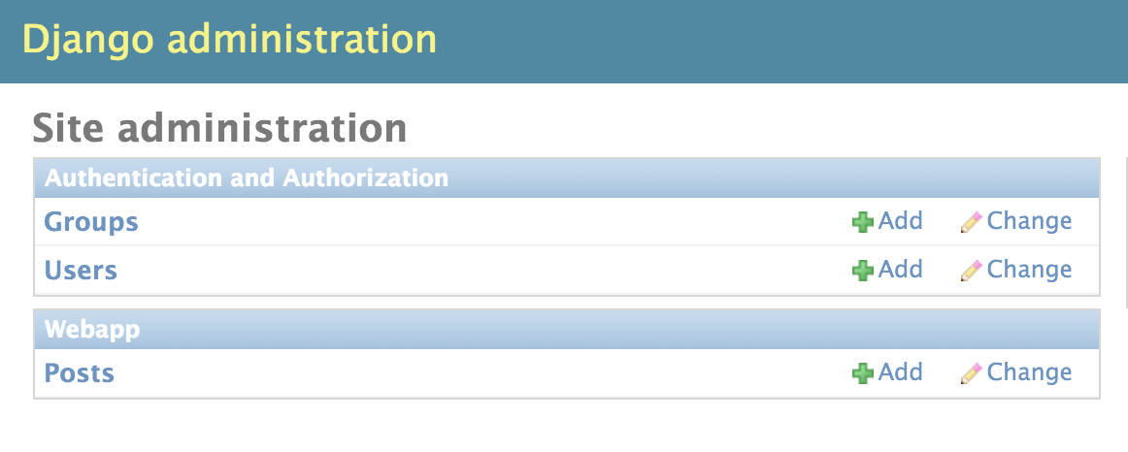
註冊MODEL
之後可於後台管理介面查看資料
myproject/blog/admin.py
admin.py
from django.contrib import admin
from .models import Post
admin.site.register(Post)
http://127.0.0.1:8000/admin/

Slide 24
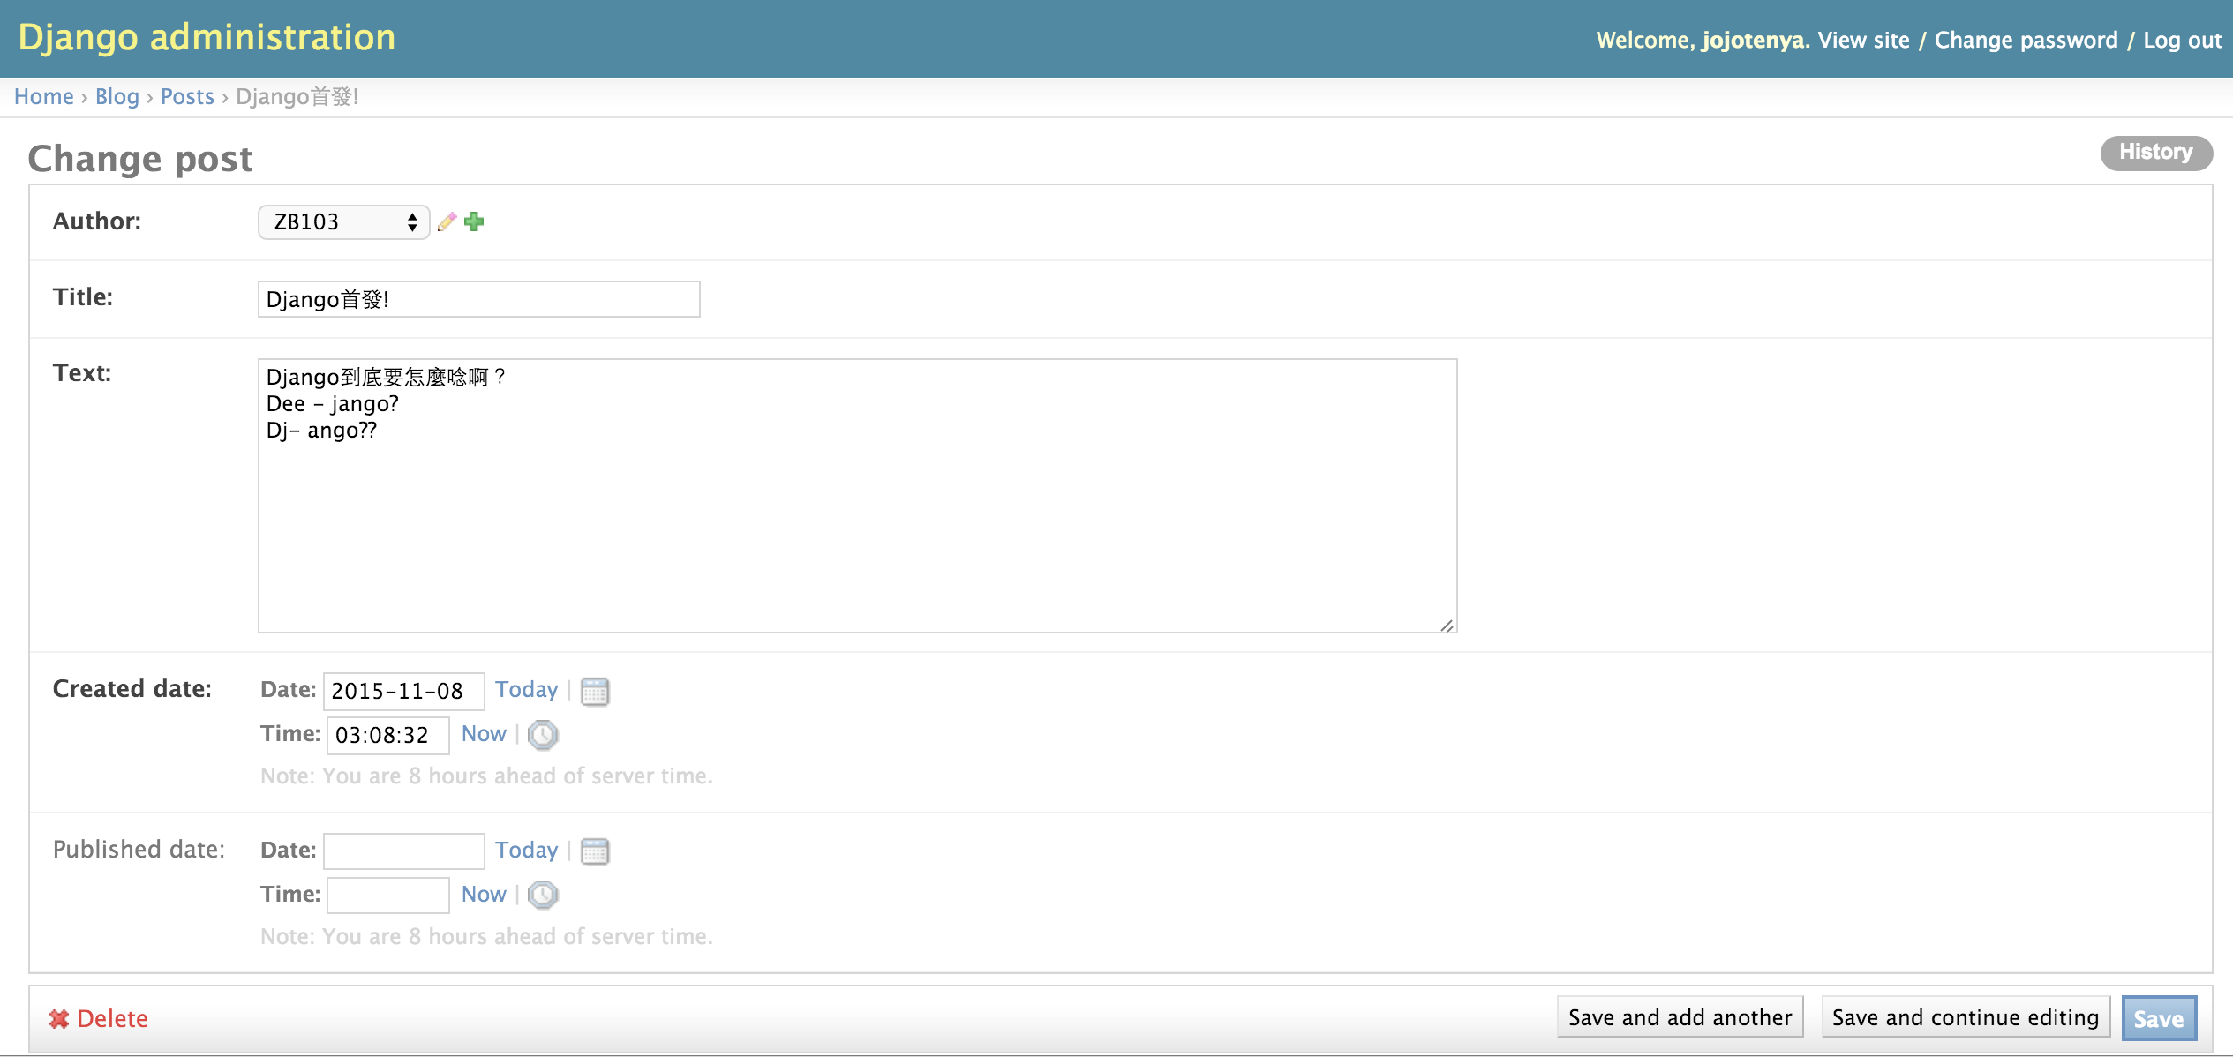
於後台新增資料進資料庫

Slide 25
URL DISPATCHER-1
myproject/project/urls.py (project 層級的urls.py)
urls.py
from django.contrib import admin
from django.urls import path, include
urlpatterns = [
path('admin/', admin.site.urls),
path('blog/', include('blog.urls')),
]

Slide 26
URL DISPATCHER-2
myproject/blog/urls.py (app 層級的urls.py)
urls.py
from django.urls import path
from . import views
urlpatterns = [
path('', views.post_list, name='post_list'),
]

Slide 27
URL DISPATCHER-3
url的位置代表的是執行哪一支View

Slide 28
VIEW
myproject/blog/views.py
views.py
from django.shortcuts import render
def post_list(request):
return render(request, 'blog/post_list.html', {})

Slide 29
TEMPLATE
blog/templates/blog/post_list.html (首先直接寫入資料看看)
post_list.html
<html>
<head>
<title>III's blog</title>
</head>
<body>
<div>
<h1><a href=“”>III's Blog</a></h1>
</div>
<div>
<p>發佈時間: 10.11.2015, 10:11</p>
<h2><a href="">Django第一天</a></h2>
<p>今天來了一個代課阿豪，講的課都聽不是很懂，還扯到什麼開餐廳~!@#$%^WTF</p>
</div>
<div>
<p>發佈時間: 11.11.2015, 11:11</p>
<h2><a href=“">Django第二天</a></h2>
<p>發現阿豪用心良苦，現在Django對我來是簡直是piece of cake ^.<，準備要請客吃飯了</p>
</div>
</body>
</html>

Slide 30

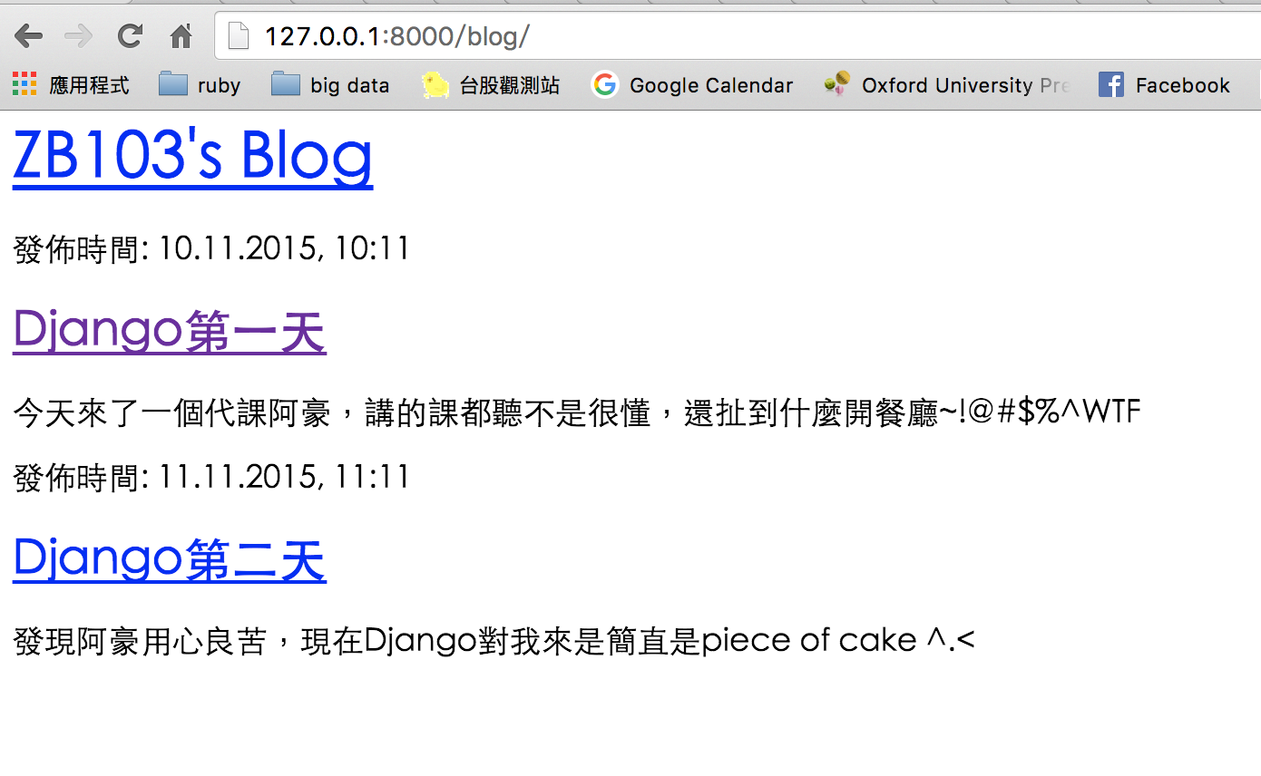
網頁出現了，好感動
127.0.0.1:8000/blog

Slide 31
用動態資料做做看
models.py
class Post(models.Model):
author = models.ForeignKey(‘auth.User’,
on_delete=models.CASCADE,null=False)
title = models.CharField(max_length=200)
text = models.TextField()
created_date = models.DateTimeField(
default=timezone.now)
views.py
from django.shortcuts import render
from django.utils import timezone
from .models import Post
def post_list(request):
posts = Post.objects.all().order_by(‘-created_date’)
return render(request, 'blog/post_list.html', {'posts': posts})

Slide 32
向資料庫下Query
SQL | Django
select * from blog_post | Post.objects.all()
select * from blog_post where title= 'Django首發!' | 單筆：Post.objects.get(id=1) 多筆：Post.objects.filter(title= 'Django首發!')
select * from blog_post order by created_date desc | Post.objects.all().order_by (‘-created_date’)
select * from blog_post where created_date <= date('now') | Post.objects.filter(created_date__lte=timezone.now())
insert into blog_post(author,title,text) value('III','test', 'test') | Post.objects.create(author=me, title='test', text='test')
註1. Django 會自動把models裡面的物件前面加上”app名稱_”當做資料庫的table名稱，如果想要
用自己設定的table名稱，請見附錄。
註2. Django下query採用ORM，其中”objects”為query管理器，為model物件自帶的參數。
註3. 右邊author=me的me為django.contrib.auth.models.User.objects.get(username=‘III')

Slide 33
動態資料塞入template
myproject/blog/templates/blog/post_list.html
post_list.html
<html>
<head>
<title>III's blog</title>
</head>
<body>
<div>
<h1><a href="/blog">III's Blog</a></h1>
</div>
<div>
{% for post in posts %}
<p>發佈時間: {{post.created_date}}</p>
<h2><a href=>{{post.title}}</a></h2>
<p>{{post.text | linebreaks}}</p>
{% endfor %}
</div>
</body>
</html>
myproject/blog/views.py
views.py
from django.shortcuts import render
from .models import Post
def post_list(request):
posts = Post.objects.all()\
.order_by(‘-created_date’)
return render(request, 'blog/post_list.html', {'posts': posts})

Slide 34
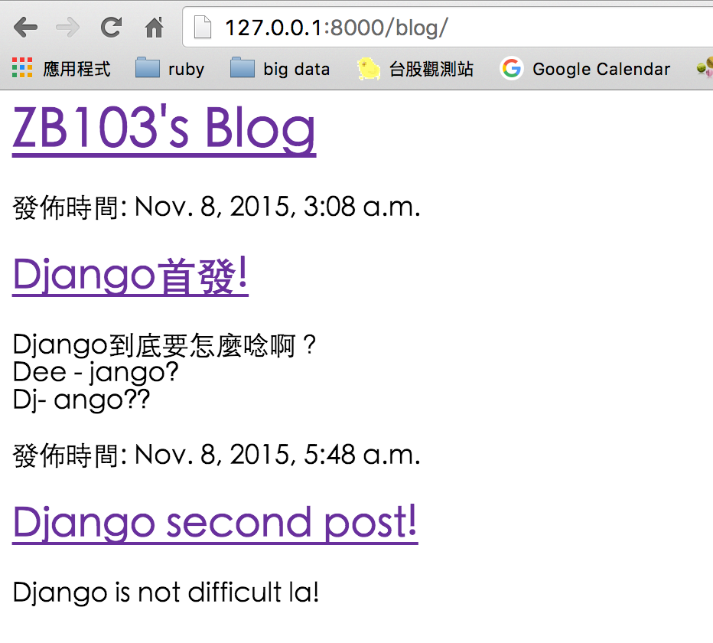
網頁出現惹，但醜醜der...

Slide 35


美化網頁神奇寶典
資策會王牌美女老師：倪老師動態網頁聖經
google字型

Slide 36
BOOTSTRAP
http://getbootstrap.com/
Bootstrap CDN:
<!-- Latest compiled and minified CSS -->
<link rel="stylesheet" href="https://maxcdn.bootstrapcdn.com/bootstrap/3.3.7/css/bootstrap.min.css">
<!-- Optional theme -->
<link rel="stylesheet" href=“https://maxcdn.bootstrapcdn.com/bootstrap/3.3.7/css/bootstrap-theme.min.css">
<!-- Latest compiled and minified JavaScript -->
<script src="https://maxcdn.bootstrapcdn.com/bootstrap/3.3.7/js/bootstrap.min.js" ></script>
註：前兩個放在post_list.html的<head></head>裡面，最後一個要用到javascript才需要放，置於<body></body>的最後
一行

Slide 37
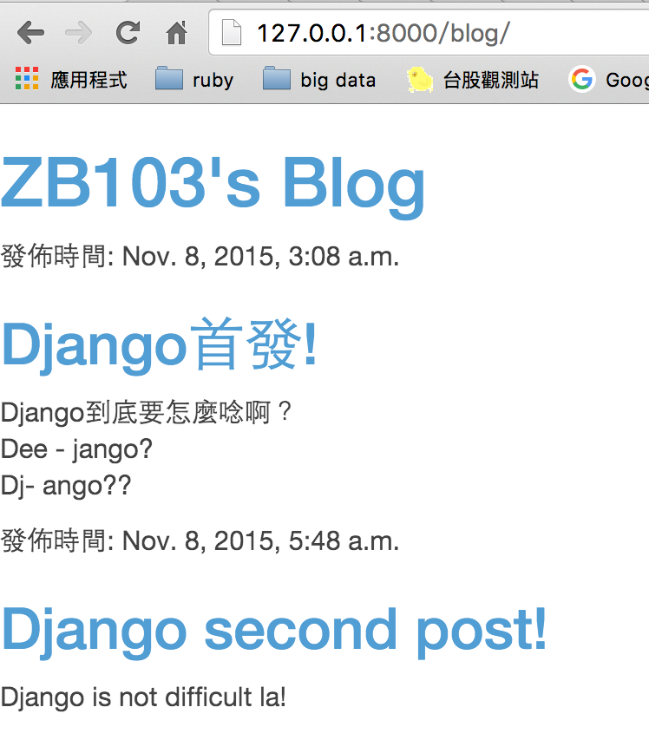
BOOTSTRAP的效果
註：可上http://getbootstrap.com/getting-started/#examples觀看一些範例

Slide 38
google字型
https://www.google.com/fonts
google font CDN:
<link href="http://fonts.googleapis.com/css?family=Lobster&subset=latin,latin-ext" rel="stylesheet" type="text/css">

Slide 39
客製化的CSS
於app(blog)底下新增static資料夾，並於static底下新增css資料夾 以放置css檔。
myproject
└─── blog
└─── static
└─── css
└─── blog.css
Django會自動偵測app底下名為static的資料夾，並將資料夾路徑存 為變量”static”，以供template載入使用。
static資料夾可存放其他靜態檔，例如javascript檔、圖檔以供template 存取。

Slide 40
套用static資料至TEMPLATE
myproject/blog/templates/blog/post_list.html
post_list.html
{% load staticfiles %}
<html>
<head>
<title>III’s blog</title>
<link rel="stylesheet" href=“//maxcdn.bootstrapcdn.com/bootstrap/3.3.7/css/bootstrap.min.css">
<!--<link rel="stylesheet" href ="/static/css/blog.css">-->
<link rel="stylesheet" href="{% static ‘css/blog.css’ %}">
</head>
註1. 檔案最開頭要寫入{% load staticfiles %}才可以存取static路徑變數
註2. 此方法好處為不管未來static資料夾如何變動都不需要擔心路徑的問題。

Slide 41
TEMPLATE
{% load staticfiles %}
<html>
<head>
<title>Iii's blog</title>
<link rel="stylesheet" href="//maxcdn.bootstrapcdn.com/bootstrap/3.3.7/css/bootstrap.min.css">
<link href="http://fonts.googleapis.com/css?family=Lobster&subset=latin,latin-ext" rel="stylesheet" type="text/css">
<link rel="stylesheet" href="{% static 'css/blog.css' %}">
<!--<link rel="stylesheet" href ="/static/css/blog.css">-->
</head>
<body>
<div class="page-header">
<h1><a href="/blog">III's Blog</a></h1>
</div>
<div class="content container">
<div class="row">
<div class="col-md-8">
{% for post in posts %}
<div class="post">
<div class="date">
<p>發佈時間: {{ post.created_date }}</p>
</div>
<h1><a href=“/blog/{{post.id}}">{{ post.title }}</a></h1>
<p>{{ post.text | linebreaks }}</p>
</div>
{% endfor %}
</div>
</div>
</div>
</body>
</html>

Slide 42
CSS檔範例
myproject/blog/static/css/blog.css
body {
padding-left: 15px;
}
h1 a {
color: #FCA205;
font-family: 'lobster';
}
.page-header {
background-color: #3AC3E3;
margin-top: 0;
padding: 20px 20px 20px 40px;
}
.page-header h1, .page-header h1 a, .page-header h1 a:visited, .page-header h1 a:active {
color: #ffffff;
font-size: 36pt;
text-decoration: none;
}
.content {
margin-left: 40px;
}
h1, h2, h3, h4 {
font-family: 'lobster', cursive;
}
.date {
float: right;
color: #828282;
}
.post {
margin-bottom: 70px;
}
.post h1 a, .post h1 a:visited {
color: #000000;
}

Slide 43
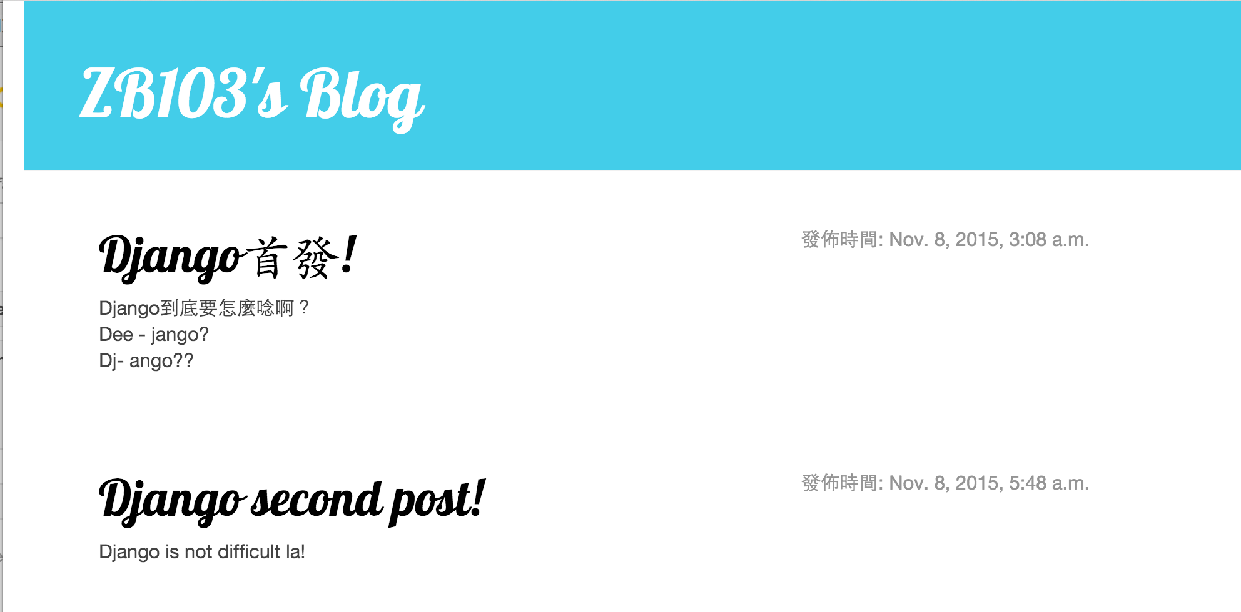
好像有好看一點

Slide 44
加入表單-1
myproject/blog/forms.py
from django import forms
class PostForm(forms.Form):
title = forms.CharField(max_length=100)
text = forms.CharField(max_length=2000, widget = forms.Textarea())

Slide 45
加入表單-2
myproject/blog/templates/blog/post_list.html
…
<div class="row">
<div class="col-md-8">
<h4>發佈新文章:</h4>
</div>
<div class="col-md-8">
<form action="/blog/add_record" method="post" accept-charset="utf-8">
<table>
{{post_form.as_table}}
</table>
<input type="submit" name="add_record" value="提交">
</form>
</div>
</div>
…

Slide 46
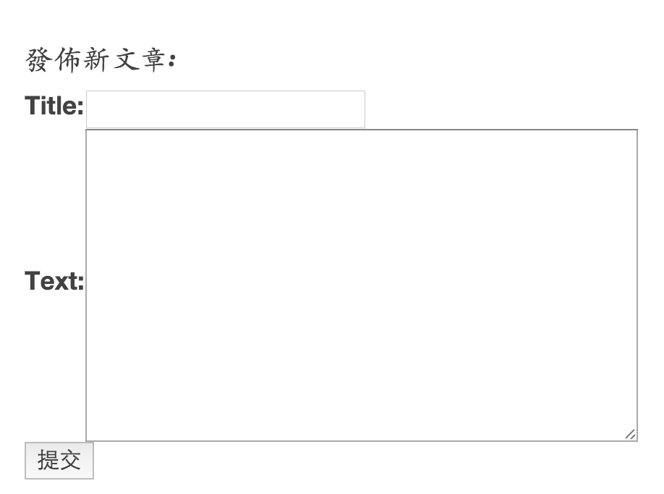
加入表單-3
127.0.0.1:8000/blog/

Slide 47
加入表單-4
myproject/blog/urls.py
urls.py
from django.urls import include, path
from . import views
urlpatterns = [
path(‘add_record’, views.add_record, name='add_record'),
path('', views.post_list, name='post_list'),
]

Slide 48
加入表單-5
myproject/blog/views.py
views.py
…
from .forms import PostForm
from django.contrib.auth import get_user_model
from django.shortcuts import redirect
me = get_user_model().objects.get(username='usename')
…
def add_record(request):
if request.POST:
title = request.POST['title']
text = request.POST['text']
newpost = Post.objects.create(author=me, title=title, text=text)
return redirect('/blog')

Slide 49
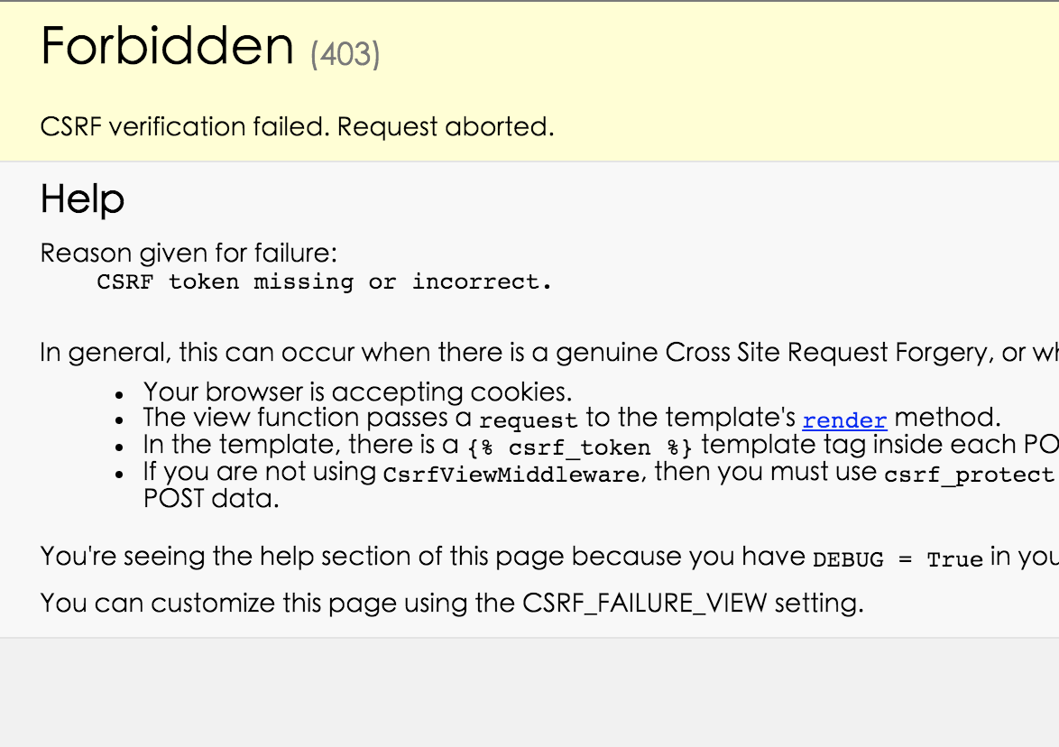
CSRF(Cross-Site Request Forgery)
127.0.0.1:8000/blog/

Slide 50



CSRF(Cross-Site Request Forgery)
valid!
valid!
response
user/password
cookie
cookie
response

Slide 51

CSRF(Cross-Site Request Forgery)
valid!
cookie
response
cookie

Slide 52

Avoid CSRF
show me the
money
csrf token!
valid!
user/password
CSRF token
(to HTTP header)

Slide 53
Avoid CSRF
No token?
get out of my sight!
cookie
Header
without
csrf token
response
cookie
Header
without
csrf token

Slide 54
CSRF_TOKEN
myproject/blog/templates/blog/post_list.html
…
<div class="row">
<div class="col-md-8">
<h4>發佈新文章:</h4>
</div>
<div class="col-md-8">
<form action="/blog/add_record" method="post" accept-charset=“utf-8">
{% csrf_token %}
<table>
{{post_form.as_table}}
</table>
<input type="submit" name="add_record" value="提交">
</form>
</div>
</div>
…

Slide 55
CSRF_EXEMPT
myproject/blog/views.py
views.py
…
from .forms import PostForm
from django.contrib.auth import get_user_model
from django.shortcuts import redirect
from django.views.decorators.csrf import csrf_exempt
me = get_user_model().objects.get(username=‘III’)
…
@csrf_exempt
def add_record(request):
if request.POST:
title = request.POST['title'].encode('utf-8')
text = request.POST['text'].encode('utf-8')
newpost = Post.objects.create(author=me, title=title, text=text)
return redirect('/blog')

Slide 56
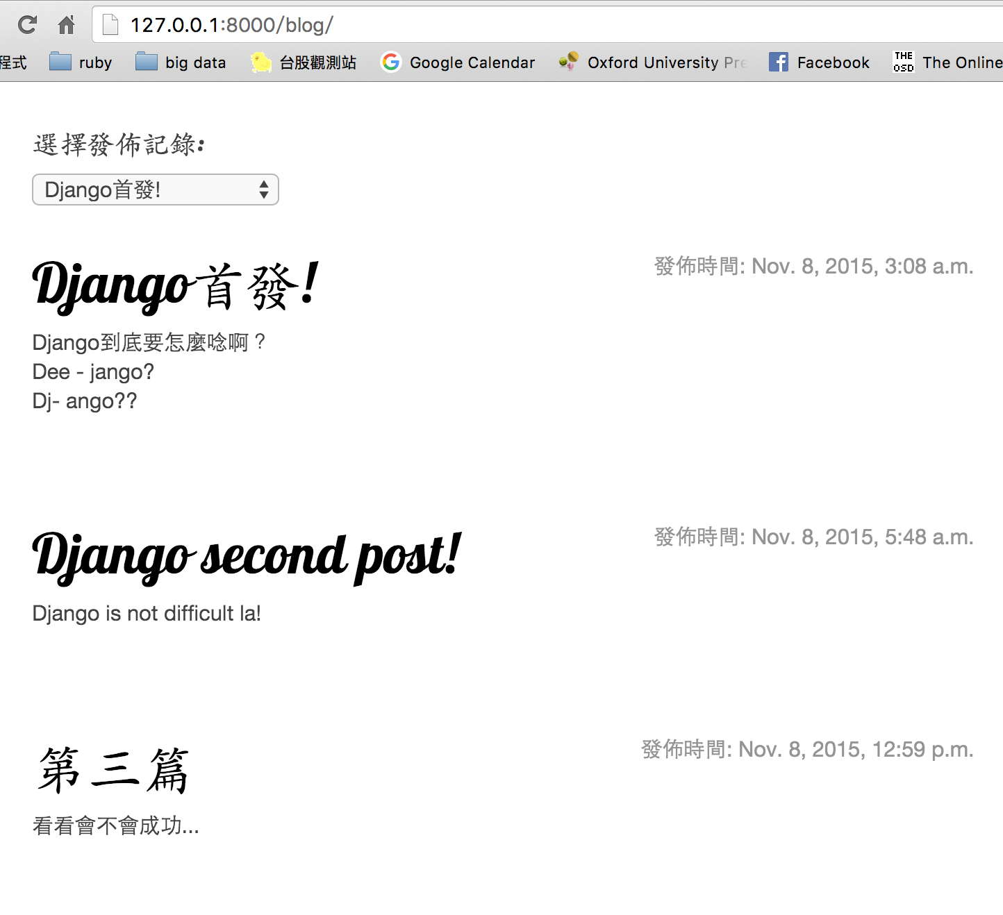
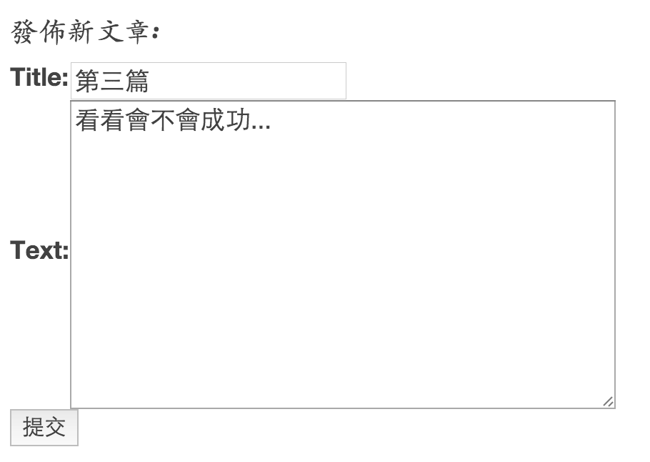
表單發送成功

Slide 57
用url跨頁傳遞資料-1
myproject/blog/urls.py
urls.py
from django.urls import path
from . import views
urlpatterns = [
path('add_record', views.add_record, name='add_record'),
path('<int:id>', views.post_record, name='post_record'),
path('', views.post_list, name='post_list'),
]

Slide 58
用url跨頁傳遞資料-2
myproject/blog/views.py
views.py
…
def post_record(request,id):
post = Post.objects.get(id = id)
return render(request, 'blog/post_record.html', locals())
…

Slide 59
用url跨頁傳遞資料-3
myproject/blog/templates/blog/post_record.html
{% load staticfiles %}
<html>
<head>
<title>III's blog</title>
<link rel="stylesheet" href="//maxcdn.bootstrapcdn.com/bootstrap/3.3.7/css/bootstrap.min.css">
<link href="http://fonts.googleapis.com/css?family=Lobster&subset=latin,latin-ext" rel="stylesheet" type="text/css">
<link rel="stylesheet" href="{% static 'css/blog.css' %}">
</head>
<body>
<div class="container">
<div class="blog-header">
<h1 class="blog-post-title">{{ post.title }}</h1>
</div>
<div class="row">
<div class="col-sm-8 blog-main">
<div class="blog-post">
<p>
{{ post.text }}
</p>
<p class="blog-post-meta">{{ post.created_date }} by <a href="#">{{ post.author }}</a></p>
<a href="/blog/" >回首頁</a>
</div>
</div>
</div>
</div>
</body>
</html>

Slide 60
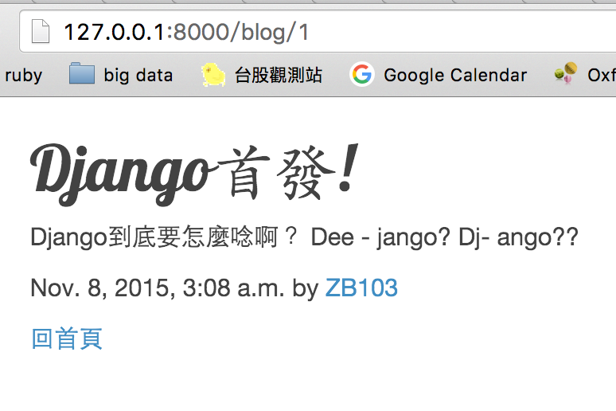
成功換頁

Slide 61
分頁也想共用主頁版面

Slide 62
模版進階應用:繼承-1
建立 base.html
{% load staticfiles %}
<html>
<head>
<title>III's blog</title>
<link rel="stylesheet" href="//maxcdn.bootstrapcdn.com/bootstrap/3.3.7/css/bootstrap.min.css">
<link href="http://fonts.googleapis.com/css?family=Lobster&subset=latin,latin-ext" rel="stylesheet" type="text/css">
<link rel="stylesheet" href="{% static ‘css/blog.css’ %}">
</head>
<body>
<div class="page-header">
<h1><a href="/blog">III's Blog</a></h1>
</div>
{% block content %}{% endblock %}
</body>
</html>

Slide 63
模版進階應用:繼承-2
修改 post_record.html:
{% extends 'blog/base.html' %}
{% block content %}
<div class="container">
<div class="blog-header">
<h1 id="blog-post-title" class="blog-post-title">{{ post.title }}</h1>
</div>
<div class="row">
<div class="col-sm-8 blog-main">
<div id="blog-post" class="blog-post">
<p>
{{ post.text }}
</p>
<p class="blog-post-meta">{{ post.created_date }} by <a href="#">{{ post.author }}</a></p>
<a href="/blog/" >回首頁</a>
<p id="current_page"> {{post.id}} </p>
</div>
</div>
</div>
</div>
{% endblock %}

Slide 64
模版進階應用:繼承-3
修改 post_list.html:
{% extends 'blog/base.html' %}
{% block content %}
<div class="content container">
<div class="row">
<div class="col-md-8">
{% for post in posts %}
<div class="post">
<div class="date">
<p>發佈時間: {{ post.created_date }}</p>
</div>
<!--<h1><a href="/blog/{{post.id}}">{{ post.title }}</a></h1>-->
<h1><a href={% url 'post_record' post.id %}>{{ post.title }}</a></h1>
<p>{{ post.text|linebreaks }}</p>
</div>
{% endfor %}
</div>
</div>
….(略)....
</div>
{% endblock %}

Slide 65
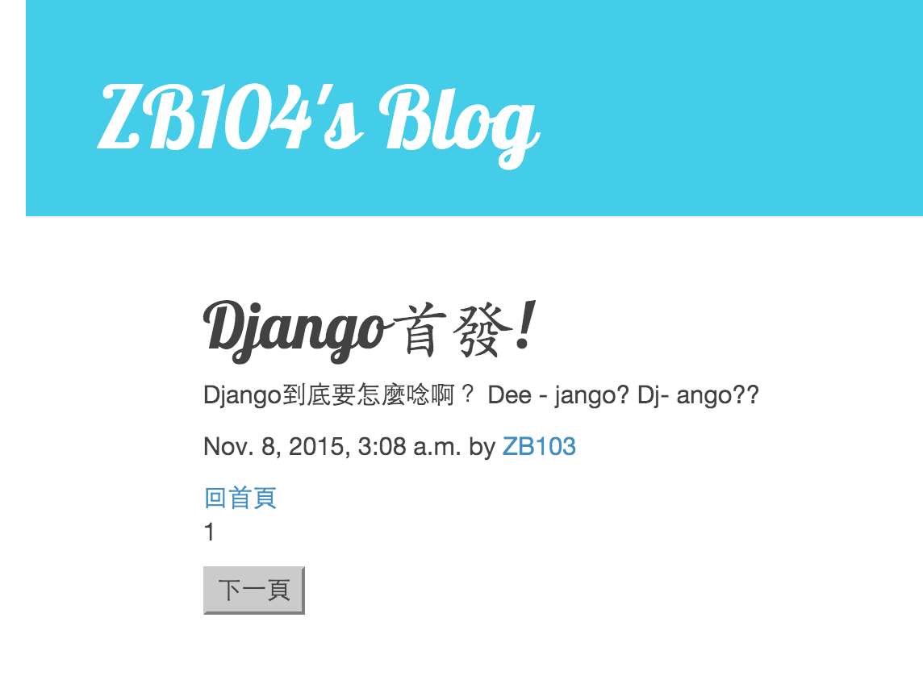

Slide 66

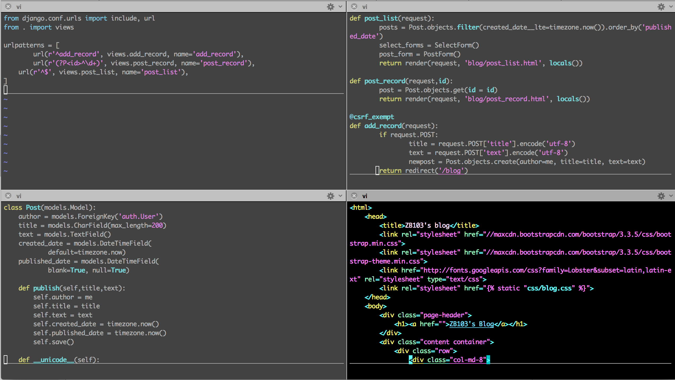
總複習
urls.py
views.py
models.py
template

Slide 67
Demo
一週新聞 (https://github.com/jojotenya/news_dashboard_demo.git)
即時人臉辨識 (https://github.com/jojotenya/realtime_face_detection.git)

Slide 68
Other Tools:
Python: Dash (五顆星，文件清楚)
Python: Bokeh (less recommend)
Django + D3.js (更多的客製化)
R: shinyapps (五顆星，速度快！)
Tableau

Slide 69
附錄：Foreignkey on_delete參數
CASCADE:Cascade deletes. Django emulates the behavior of the SQL constraint ON DELETE CASCADE and also deletes the object containing the ForeignKey.
PROTECT:Prevent deletion of the referenced object by raising ProtectedError, a subclass of django.db.IntegrityError.
SET_NULL:Set the ForeignKey null; this is only possible if null is True.
SET_DEFAULT:Set the ForeignKey to its default value; a default for the ForeignKey must be set.
SET():Set the ForeignKey to the value passed to SET(), or if a callable is passed in, the result of calling it. In most cases, passing a callable will be necessary to avoid executing queries at the time your models.py is imported
DO_NOTHING:Take no action. If your database backend enforces referential integrity, this will cause an IntegrityError unless you manually add an SQL ON DELETE constraint to the database field.

Slide 70
Queryset-Methods Cheat Sheet
Methods | 說明 | example
get | 取一特定的記錄 | Post.objects.get(id=1)
create | 新增記錄 | Post.objects.create(author=me, title='test', text='test')
update | 更新記錄 | Post.objects.filter(id=1).update(title='test')
get_or_create | 檢查是否存在，存在則取值，不存在則新增 | created = Person.objects.get_or_create(first_name='John')
update_or_create | 檢查是否存在，存在則更新，不存在則新增 | created = Person.objects.update_or_create(first_name='John')
delete | 刪除記錄 | Post.objects.filter(id=1).delete()
first | 取第一個值 | p = Post.objects.order_by( 'pub_date').first()
last | 取最後一個值 | p = Post.objects.order_by( 'pub_date').last()
count | 計算符合的個數 | Post.objects.filter(title__contains='Django').count()

Slide 71
Queryset-Field lookups Cheat Sheet
Field lookups | 說明 | example
exact | 與指定內容完全相等 | Post.objects.get(id__exact=14)
iexact | 與指定內容相等但不分大小寫 | Post.objects.get(title__iexact='My first blog')
contains | 包含指定的值 | Post.objects.get(title__contains='Django')
icontains | 同上但不分大小寫 | Post.objects.get(title__icontains='django')
in | 在指定的list當中 | Post.objects.filter(id__in=[1, 3, 4])
gt | 大於指定的內容 | Post.objects.filter(id__gt=4)
gte | 大於等於指定的內容 | Post.objects.filter(id__gte=4)
lt | 小於指定的內容 | Post.objects.filter(id__lt=4)
lte | 小於等於指定的內容 | Post.objects.filter(id__lte=4)
startswith | 以指定的字串作為開頭 | Post.objects.filter(title__startswith='django')
endswith | 以指定的字串做結尾 | Post.objects.filter(title__endswith='django')
isnull | SELECT ... WHERE … IS NULL; | Post.objects.filter(publish_date__isnull=True)
regex | 用正則表達式來查找內容 | Post.objects.get(title__regex=r'^(An?|The) +')

Slide 72
附錄：Queryset-Create & Update
 | 方法一、 | 方法二、
Create | Post.objects.create(author=me, title='test', text='test') | p = Post() p.author = me p.title =‘test' p.text = ‘test' p.save()
Update | Post.objects.filter(id=1).update(title='test') | p = Post.objects.filter(id=1) p.author = me p.title =‘test' p.text = ‘test' p.save()

Slide 73
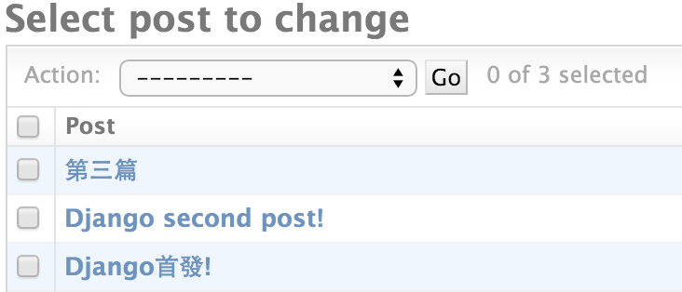
附錄：Model小補充
python manage.py shell
>>>p = Post.objects.get(id=1)
>>>print p
Django首發!
__str__方法決定呼叫物件時的代表名稱：
models.py
from django.db import models
from django.utils import timezone
class Post(models.Model):
…
def __str__(self):
return self.title
127.0.0.1/admin/blog/post/

Slide 74
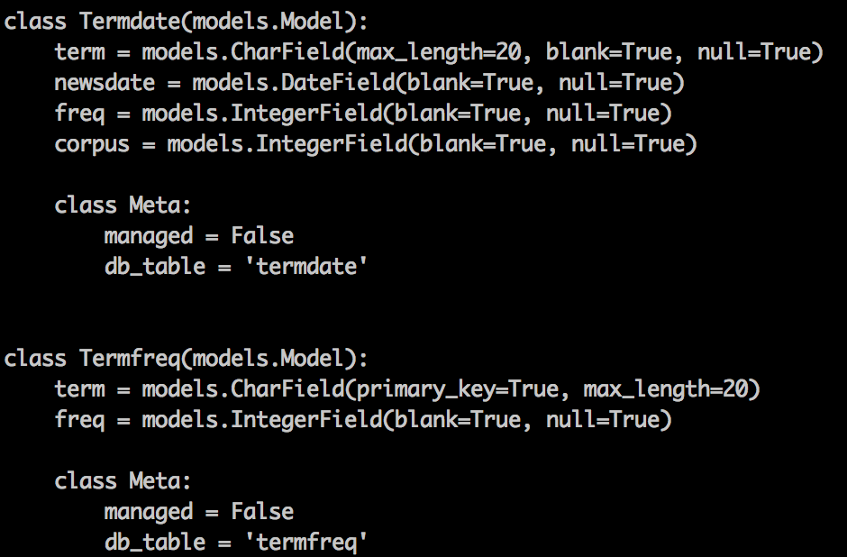
附錄：已經有資料在資料庫怎麼辦
myproject/
執行 python manage.py inspectdb 觀看目前綁定的資料庫的結構
執行 python manage.py inspectdb > models.py 將結果存入models.py
執行 python manage.py migrate 完成同步

Slide 75
附錄：連接各種資料庫
myproject/project/settings.py
DATABASES = {
'default': {
'ENGINE': ‘django.db.backends.postgresql_psycopg2',
'NAME': 'dbname',
'USER': 'root',
'PASSWORD': '',
'HOST': '',
'PORT': '',
}
}
postgredb
DATABASES = {
'default': {
'ENGINE': 'sqlserver_ado',
'NAME': 'dbname',
'USER': 'root',
'PASSWORD': '',
'HOST': 'dbserver\\ss2008',
'PORT': '',
}
}
DATABASES = {
'default': {
'ENGINE': 'django.db.backends.mysql',
'NAME': 'dbname',
'USER': 'root',
'PASSWORD': '',
'HOST': 'localhost',
'PORT': '3306',
}
}
sqlserver
mysql
註：sql server 詳見http://django-mssql.readthedocs.org/en/latest/

Slide 76
附錄：request 介紹 <HttpRequests類別的實作物件>
自帶參數(常用)：
request.path: 請求此view的路徑。
request.method: 此次請求的HTTP方法。
ex. request.method == ‘POST’會回傳boolean。
request.POST/request.GET: 回傳 POST/GET 方法傳遞的dictionary-like物件。
request.COOKIES: 此次請求所帶的所有cookies。
request.META: 此次請求所有HTTP headers，為一dictionary，可用字典方法request.META.items()取得所有key-value。
middle-ware設置的參數：
request.session: 一個dictionary-like物件，用來存取session。
ex. request.session[‘id’] = 1，可存入一個key=‘id’,value=1的session物件。
request.user: 如果網站有設置使用者，並且該使用者登入的情況之下，可由此取得AUTH_USER_MODEL物件，無登入情況之下會獲得AnonymousUser物件。
自帶方法(常用)：
request.get_full_path(): GET方法有帶查詢字符時的完整路徑。
ex. /blog/?page=1
request.get_host(): 得到主機(網域)名稱。

Slide 77
jojotenya@gmail.com

